Slide 1

ECO (Economic Cooperation organization)
By Fawwaz, Talha and Awais

Slide 2
ECO (Economic Cooperation organization)
By Fawwaz, Talha and Awais

Slide 4
ECO
Introduction
Background
ECO Role
Structure
Objectives
Cooperation
Institutions under ECO

Slide 5
Introduction:
RCD (1964 – 1979)
Pakistan , Turkey , Iran
ECO(1985)
28 – Nov –1992 (7 countries)
Members 10
Official language
Headquarters – Tehran – Iran

Slide 6
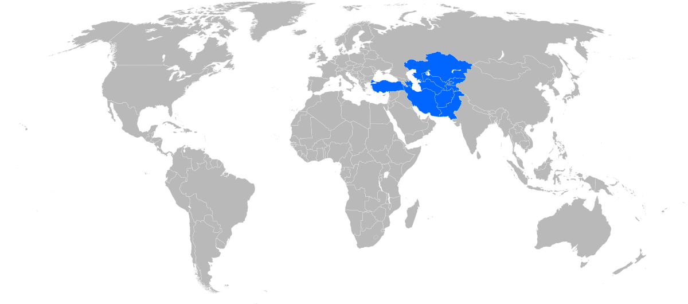

Slide 8
Background:
RCD 1964 to 1979
Iran Revolution 1979 (1976 – 1983)
Treaty of Izmir 1976 – Legal framework
Amendment in 1990
June 1990 – ECO legal framework – Islamabad
ECO LOUNCED – 11 JAN 1991 – Functional
NEW GOALS(Economical , cultural , technical)

Slide 9
ECO role :
IP(Gas Pipeline)
Pak – Turk
Military Operations
Islamabad , Tehran , Istanbul Railway

Slide 10
Structure (Administration)
In structure we have
Secretaries – Tehran ( Iran)
Decision – council of Ministers
Meeting once a year
Council of permanent members
General secretariat
Regional planning council
WORK
Working on plans
Arrange meetings
Set connections b/w member countries

Slide 11
OBJECTIVES
Sustainable economic growth
Removal of trade barriers
Promotion of trade and development
Mineral resources utilization
Agriculture growth
Cultural exchange

Slide 12
Cooperation
Economic Cooperation
Trade and investment
Transport and connectivity
Energy Collaboration
Cultural and social collaboration
Tourism promotion

Slide 13
Institutions Under ECO
ECO Trade and Development Bank (ETDB)
ECO Chamber of Commerce and Industry (ECO-CCI)
ECO Cultural Institute (ECI)
ECO Science Foundation (ECOSF)
ECO Reinsurance Company (ECORC):

Slide 14
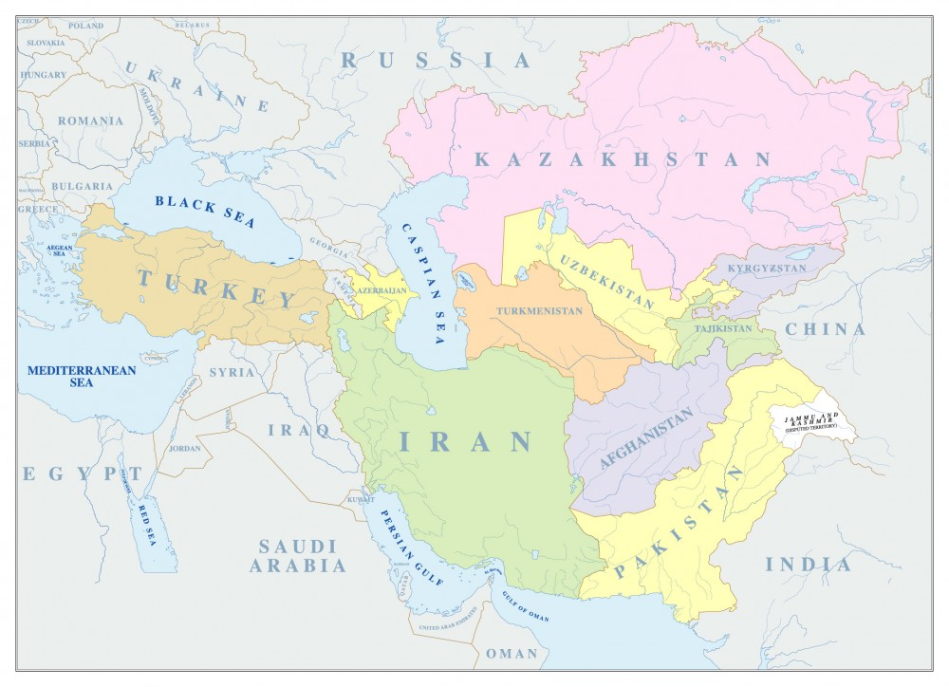

Slide 15
Lets Discuss about Projects..!

Slide 16
Endorsement of the Preferential Tariff
Agreement (PTA) :
promote intra-regional trade
elimination of all tariff and non-tariff barriers on export
co-operation in transport
Communication
infrastructure development to strengthen strong economic ties
1,92

Slide 17
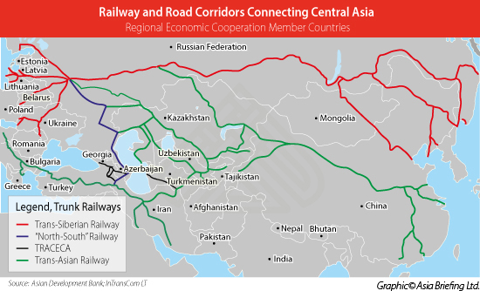
Routes for Transportation of Goods:
Islamabad-Tehran-Istanbul (ITI) Road Transport Corridor
Kyrgyz-Tajikistan-Afghanistan-Iran (KTAI) Road Transport Corridor

Slide 21
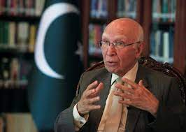
3,95
ECO travel profession assertion (TTA):
For benefits of the business visa relaxation by Air
Reinsurance Company - Karachi

Slide 22
ECO travel profession assertion (TTA):
For benefits of the business visa relaxation by Air
Reinsurance Company - Karachi
3,95

Slide 23
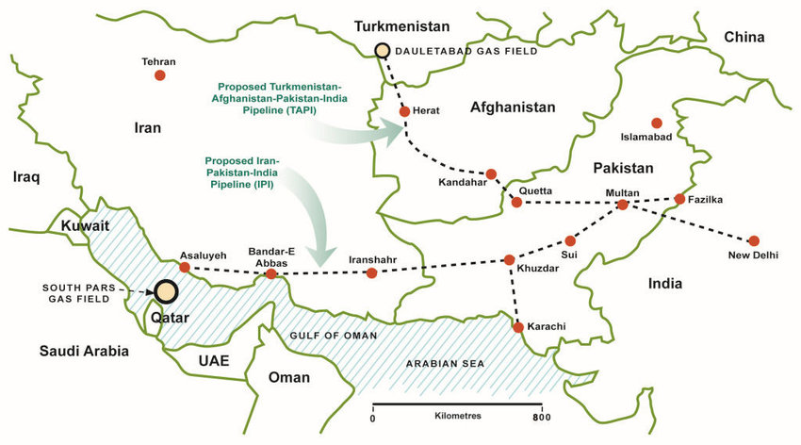
Plans for oil and gas Pipeline Routes:
6,00

Slide 25
providing technical and financial assistance
Transfer of technology
Rural poverty alleviation
Energy efficiency
7,02
Trade investments:

Slide 26
Trade investments:
providing technical and financial assistance
Transfer of technology
Rural poverty alleviation
Energy efficiency
7,02

Slide 27
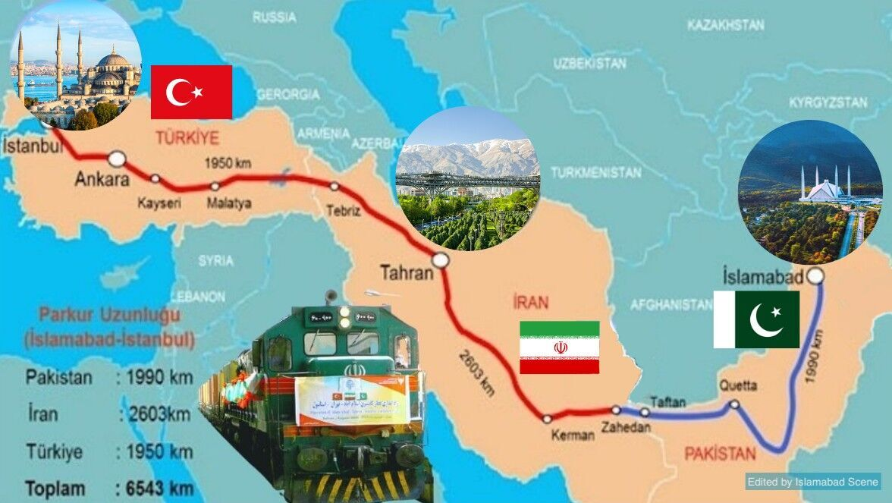
11,10
Bank was established in 2005 - Istanbul
Railway from Islamabad to Istanbul
Trade and Development Bank and cargo-rail project:

Slide 28
Trade and Development Bank and cargo-rail project:
Bank was established in 2005 - Istanbul
Railway from Islamabad to Istanbul
11,10

Slide 29
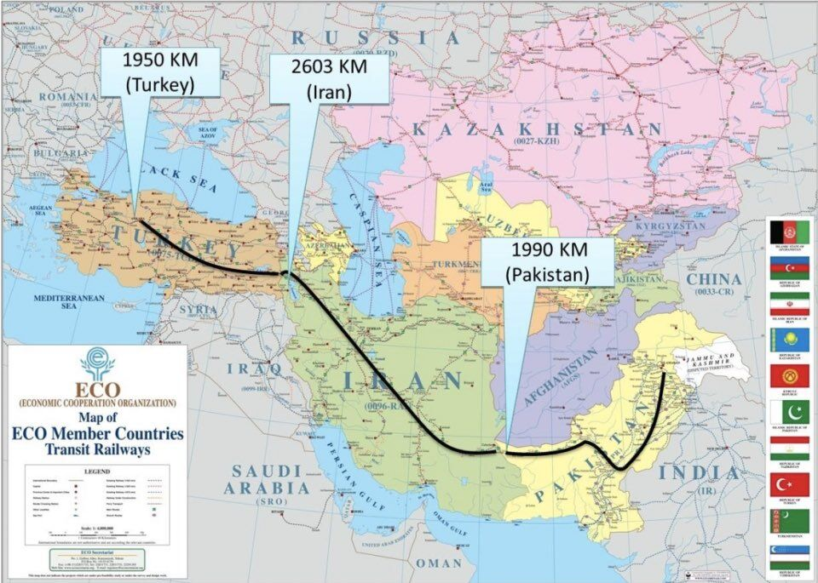

Slide 32
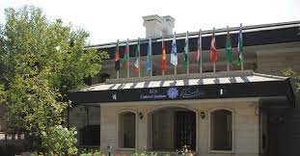
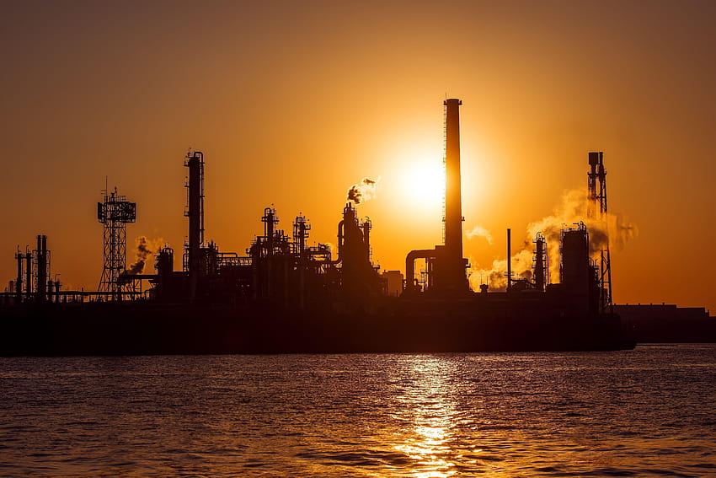
Engineering Company and ECO Cultural Institute :

Slide 33
Engineering Company and ECO Cultural Institute :

Slide 34
What are the Possible Benefits of ECO..!

Slide 36
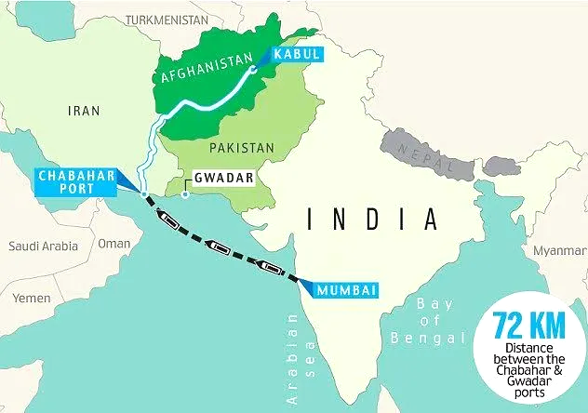
Relations with India and Iran:

Slide 38
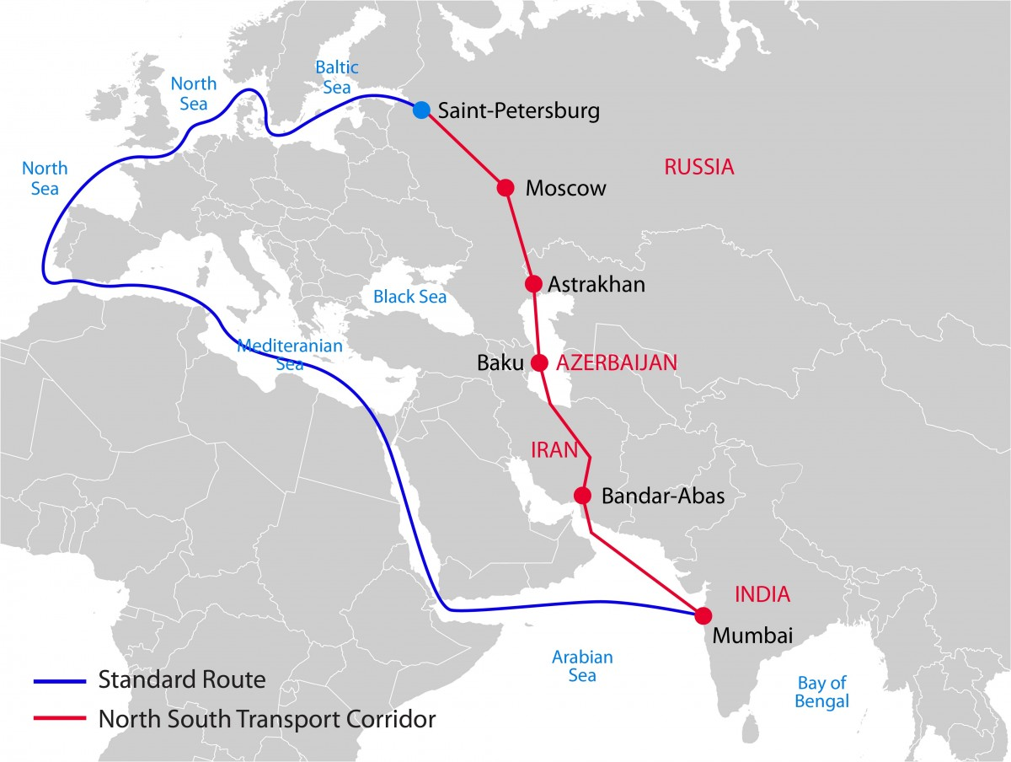

Slide 39
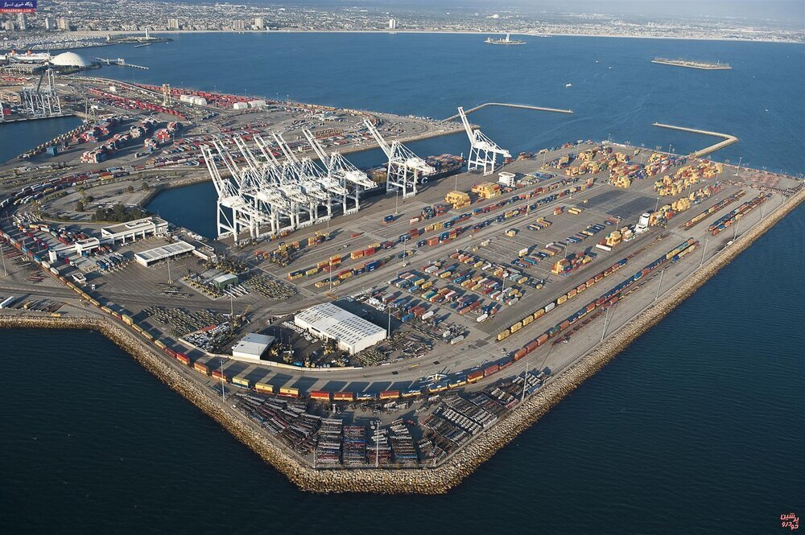

Slide 40
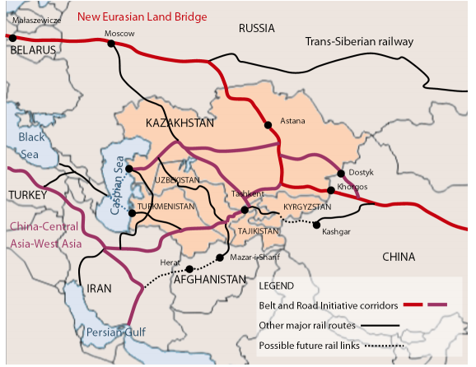
Including China and Russia in ECO:

Slide 42
Some others are:
Correct picture of Islam
Single market EU/ASEAN
Good economy
Religious Harmony
Road to Russia , CARS & Europe
Building Pressure on India and Israel
World Pease through

Slide 43
Problems Faced by ECO:
Overall backwardness
International pressure
Poor economy
Less financial and other resources
Shia- Sunni Conflict
USA role in Persian Gulf
India – Iran ties

Slide 44


